Slide 1
Production System

Slide 2
Production systems are computer programmes that give AI. It consists of a set of rules about behaviour and includes the mechanism required to follow those rules as the system reacts to external conditions. In AI, a production system consists of a global database, production rules, and a control system.

Slide 3
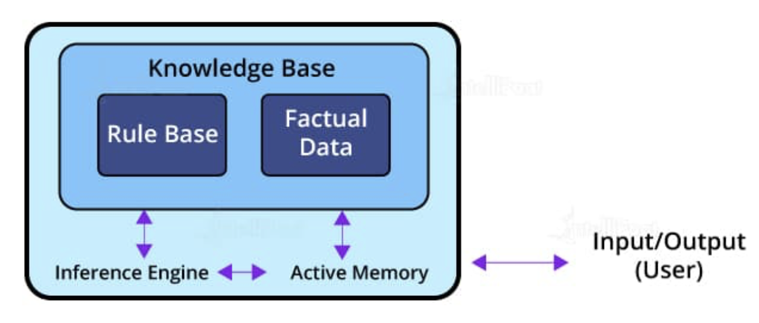
Production System

Slide 4
The architecture of a production system in Artificial Intelligence consists of production rules, a database, and the control system.
Global Database
A global database consists of the architecture used as a central data structure. A database contains all the necessary data and information required for the successful completion of a task. It can be divided into two parts as permanent and temporary. The permanent part of the database consists of fixed actions, whereas the temporary part alters according to circumstances.

Slide 5
Production Rules
Production rules in AI are the set of rules that operate on the data fetched from the global database. Also, these production rules are bound with precondition and postcondition that gets checked by the database. If a condition is passed through a production rule and gets satisfied by the global database, then the rule is successfully applied. The rules are of the form A®B, where the right-hand side represents an outcome corresponding to the problem state represented by the left-hand side.

Slide 6
Control System
The control system checks the applicability of a rule. It helps decide which rule should be applied and terminates the process when the system gives the correct output. It also resolves the conflict of multiple conditions arriving at the same time. The strategy of the control system specifies the sequence of rules that compares the condition from the global database to reach the correct result.

Slide 7
Characteristics of Production System
Simplicity
Modularity
Modifiability
Knowledge intensive

Slide 8
Disadvantages
Opacity
Communication between the rule interpreter and the production rules creates difficulty for the understanding of the control system and its strategies. This condition arises due to the impact of the combined operation of the control program. There exist difficulties in understanding the hierarchy of operations.
Inefficiency
There are various rules that we employ for solving a problem. The rules can be effective in different ways. There are conditions where multiple rules get activated during execution. All the individual rules apply exhaustive searches in each cycle that reduces the efficiency of the production system.

Slide 9
Inability to Learn
A simple production system based on certain rules is not capable of learning through experience, unlike advanced AI systems. They are simply bound to specific rules for actions. We can understand the rules and break them.
Conflict Resolution
To satisfy a condition, various production rules are employed. The condition may arise when there is a triggering of more than one rule. In that condition, the control system has to determine the best possible rule from the set of conflicting rules. This may reduce the efficiency of the production system.

Slide 10
Types
Monotonic Production System
In this type of a production system, the rules can be applied simultaneously as the use of one rule does not prevent the involvement of another rule that is selected at the same time. Bactracking may or may not be there, non reversible
Partially Commutative Production System- solve ignorable problems
This class helps create a production system that can give the results even by interchanging the states of rules. If using a set of rules transforms State A into State B, then multiple combinations of those rules will be capable to convert State A into State B.
Non-monotonic Production System-
This type of a production system increases efficiency in solving problems. The implementation of these systems does not require backtracking to correct the previous incorrect moves. The non-monotonic production systems are necessary from the implementation point of view to find an efficient solution.
Commutative System- irreversible changes
Commutative systems are helpful where the order of an operation is not important. Also, problems where the changes are reversible use commutative systems. On the other hand, partially commutative production systems help in working on problems, where the changes are irreversible such as a chemical process. When dealing with partially commutative systems, the order of processes is important to get the correct results.

Slide 11
Monotonic Reasoning is the process which does not change its direction or can say that it moves in the one direction. Non-monotonic Reasoning is the process which changes its direction or values as the knowledge base increases. Monotonic Reasoning deals with very specific type of models, which has valid proofs.
Commutative systems are helpful where the order of an operation is not important. Also, problems where the changes are reversible use commutative systems. On the other hand, partially commutative production systems help in working on problems, where the changes are irreversible such as a chemical process.

